Slide 1


Educational Website
CLASS:- KOC48
SUBMITTED TO:- Mrs. AASHIMA (CSE326)
School of Computer Science Engineering
Lovely Professional University, Punjab
NAMES | REGISTRATION NO. | ROLL NO.
RAHUL DILLA | 12223989 | 63
JAHNAV JAIDEEP | 12223254 | 14
PALLI MAHESH | 12223929 | 38

Slide 2
Student Declaration
This is to declare that this report has been written by us. No part of the report is copied from other sources. All the information included from other sources have been duly acknowledged. We ensure that if any part of the report is found to be copied we shall take the full responsibility for it.
Signature: RAHUL DILLA
Roll No: 63
Signature: JAHNAV JAIDEEP
Roll No: 14
Signature: PALLI MAHESH
Roll No. 38
Place: Lovely Professional University
Date: 28th December, 2022

Slide 3
CONTENT
TOPICS:-
PAGE NO.
INTRODUCTION
FEATURES OF THE PROJECT
TECHNOLOGIES USED
SCREENSHOTS
CODES
FLOW OF PROJECT
CONCLUSION
REFERENCES
1
2
3
4-6
7-10
11
12
13

Slide 4
INTRODUCTION
1.
An educational website is a huge interactive platform to present various information For different types of people: future students, current students, teachers, parents, those who want to get a new profession, etc. All the sections have to be well-balanced and organised so users can easily find everything they need.

Slide 5
FEATURES OF THE PROJECT
2.
Simplicity
Clear navigation
An effective Contact pages
Using analytics
Focusing on quality over quantity
Mobile-friendly design
Social networking

Slide 6
TECHNOLOGIES USED
3.
HTML5:
HTML stands for Hyper Text Markup Language
HTML is the standard markup language for creating web pages
HTML describes the structure of a web page
HTML consists of a series of elements
HTML elements tell the browser how to display the content
HTML elements label pieces of content such as “this is a heading”, “this is a paragraph”, “this is a link”, etc.
CSS:
CSS Stands for Cascading Style Sheets
CSS describes how HTML elements are to be displayed on screen, paper, or in other media
CSS saves a lot of work. It can control the layout of multiple web pages all at once
External stylesheets are stored in CSS files
SOFTWARE:
VS CODE:
Visual Studio Code also commonly referred to as VS Code, is a source-code editor made by Microsoft with the Electron Framework, for Windows, Linux . Features include support for debugging, syntax highlighting, intelligent code completion, snippets, code refactoring, embedded git
BROWSER:
MICROSOFT EDGE:
Microsoft Edge is a web browser developed by Microsoft. It was first released in 2015, replacing Internet Explorer as the default browser on Windows 10. Microsoft Edge is designed to be a light weight, secure, and fast web browser. It features an optimized layout engine, support for modern web technologies, and integration with Windows features.

Slide 7
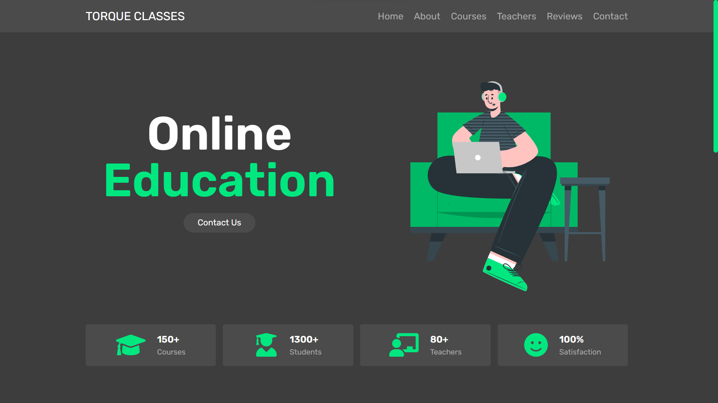
SCREENSHOTS:-
4.

Slide 8
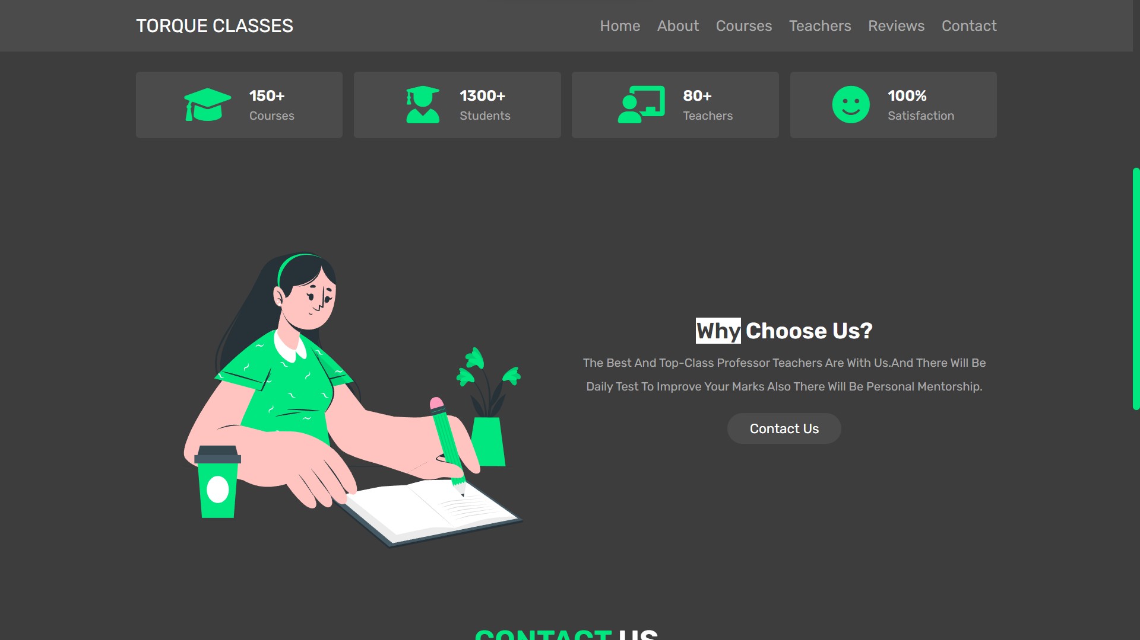
5.

Slide 9
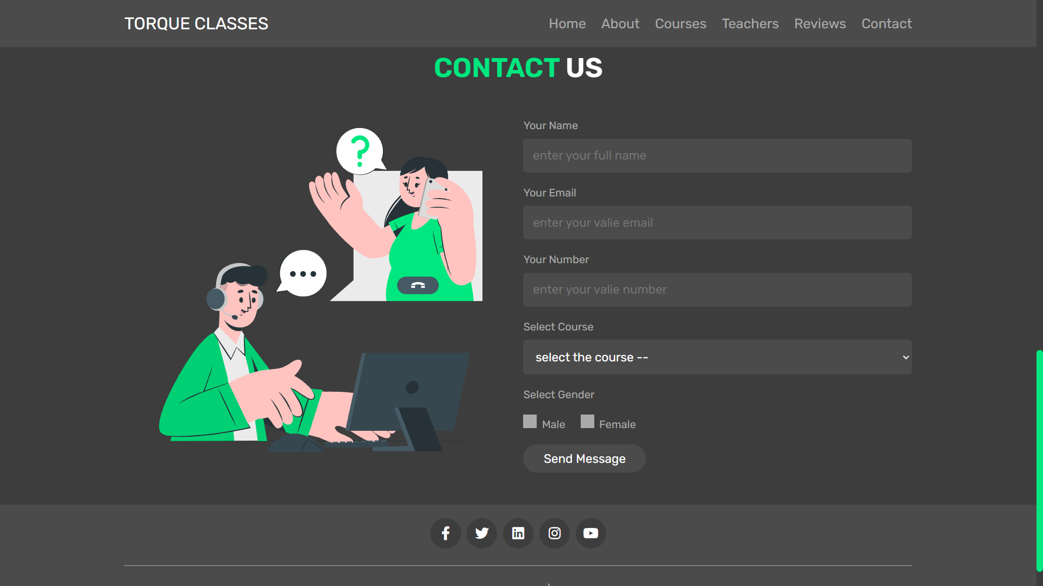
6.

Slide 10
SOURCE CODE
7.
<!DOCTYPE html>
<html lang="en">
<head>
<meta charset="UTF-8">
<meta http-equiv="X-UA-Compatible" content="IE=edge">
<meta name="viewport" content="width=device-width, initial-scale=1.0">
<title>Complete Responsive Online Education Website Design</title>
<!-- swiper css link -->
<link rel="stylesheet" href="https://unpkg.com/swiper@8/swiper-bundle.min.css" />
<!-- font awesome cdn link -->
<link rel="stylesheet" href="https://cdnjs.cloudflare.com/ajax/libs/font-awesome/6.1.1/css/all.min.css">
<!-- custom css file link -->
<link rel="stylesheet" href="css/style.css">
</head>
<body>
<!-- header section starts -->
<header class="header">

Slide 11
8.
<section class="flex">
<a href="#home" class="logo">TORQUE CLASSES</a>
<nav class="navbar">
<a href="#home">home</a>
<a href="#about">about</a>
<a href="#courses">courses</a>
<a href="#teachers">teachers</a>
<a href="#reviews">reviews</a>
<a href="#contact">contact</a>
</nav>
<div id="menu-btn" class="fas fa-bars"></div>
</section>
</header>
<!-- header section ends -->
<!-- home section starts -->

Slide 12
CSS:-
9.
@import url('https://fonts.googleapis.com/css2?family=Rubik:wght@300;400;500;600&display=swap');
:root{
--green:#00E77F;
--white:#fff;
--light-white:#aaa;
--black:#3d3d3d;
--light-bg:#4b4b4b;
}
*{
font-family: 'Rubik', sans-serif;
margin:0; padding:0;
box-sizing: border-box;
outline: none; border:none;
text-decoration: none;
transition: .2s linear;
text-transform: capitalize;
}

Slide 13
10.
*::selection{
background-color: var(--white);
color:var(--black);
}
html{
font-size: 62.5%;
overflow-x: hidden;
scroll-behavior: smooth;
scroll-padding-top: 8rem;
}
::-webkit-scrollbar{
height: .5rem;
width: 1rem;
}
::-webkit-scrollbar-track{
background-color: transparent;
}

Slide 14
FLOW OF PROJECT
11.
Back-End Developer- Rahul Dilla(63)

Slide 15
conclusion
12.
The timing has never been better for using technology to enable and improve learning at all levels, in all places, and for people of all backgrounds. From the modernization of E-rate to the proliferation and adoption of openly licensed educational resources, the key pieces necessary to realize best the transformations made possible by technology in education are in place.
Educators, policymakers, administrators, and teacher preparation and professional development programs now should embed these tools and resources into their practices. Working in collaboration with families, researchers, cultural institutions, and all other stakeholders, these groups can eliminate inefficiencies, reach beyond the walls of traditional classrooms, and form strong partnerships to support everywhere, all-the-time learning.

Slide 16
REFERENCES
13.
Portfolio of big Ed-tech industries
Google
Wikipedia

